Slide 1
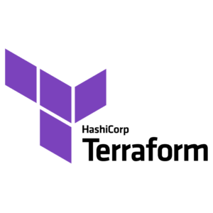
TERRAFORM PRESENTATION
BY
MOHAMMED AJLALUDDIN

Slide 2
TERRAFORM
What is Terraform?
Terraform is a infrastructure as a code
Terraform is tool used for building. Changing and versioning infrastructure safely and efficiently.
Terraform is an open source infrastructure as a code software tool that provides a consistent CLI workflow cloud service.
Terraform Language
The main purpose of the terraform language is declaring resource which represents infrastructure objects.
Terraform uses “yaml” language.

Slide 3
SYNTAX:
<BLOCK TYPE> “<BLOCK LABEL>” “<BLOCK LABEL>” { #Blockbody
<IDENTIFIER> = <EXPRESSION> #Argument
}
Block is a container for other content.
A block can have one or more labels.
The block body is present in between { }.
Within a block body, we can specify the other arguments supported by the block label.
The resource block expect two labels, one is the service and other is the user defined name for it.
Every Terraform file is saved with .tf extension (vpc.tf).

Slide 4
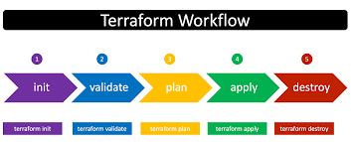
Terraform Commands
TERRAFORM INIT:- Initialize a new or existing terraform configuration.
TERRAFORM VALIDATE:- Validate the terraform files.
TERRAFORM PLAN:- Generate and show execution plan.
TERRAFORM FMT:- To make the script in correct format.
TERRAFORM APPLY:- To build and change the infrastructure.
TERRAFORM DESTROY:- To destroy the infrastructure.

Slide 5
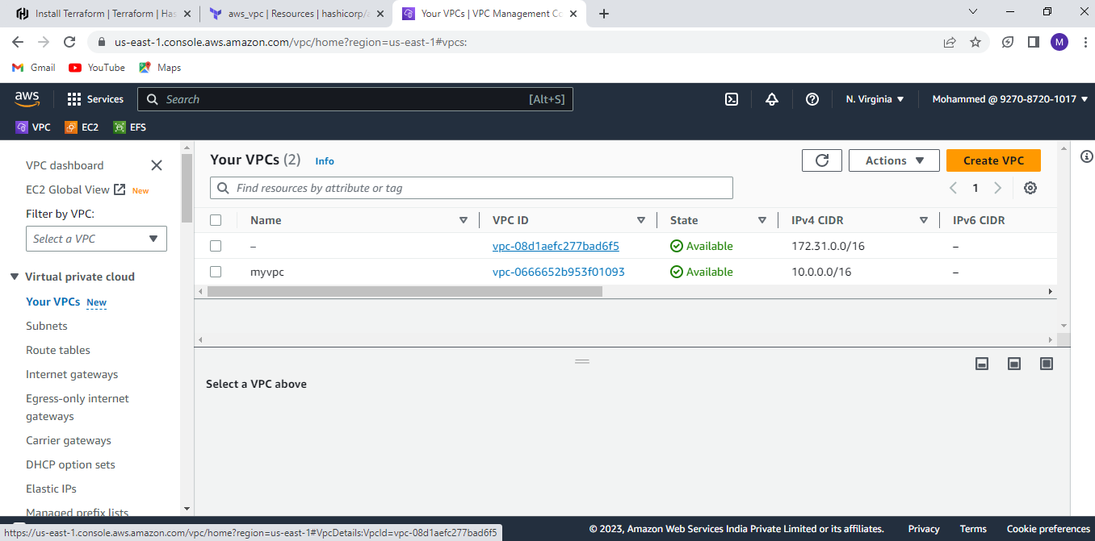
EXAMPLES 1:- Create VPC by using Terraform.
Give file name with .tf extension(VPC.tf).
resource “aws_vpc” “myvpc” {
cidr_block = “10.0.0.0/16”
tags = {
Name = “myvpc”
}
}
Here,
Block Type = Resource
Block Label 1 = aws_vpc
Block Label 2 = myvpc
Identifier = cidr_block
Expression = 10.0.0.0/16

Slide 6
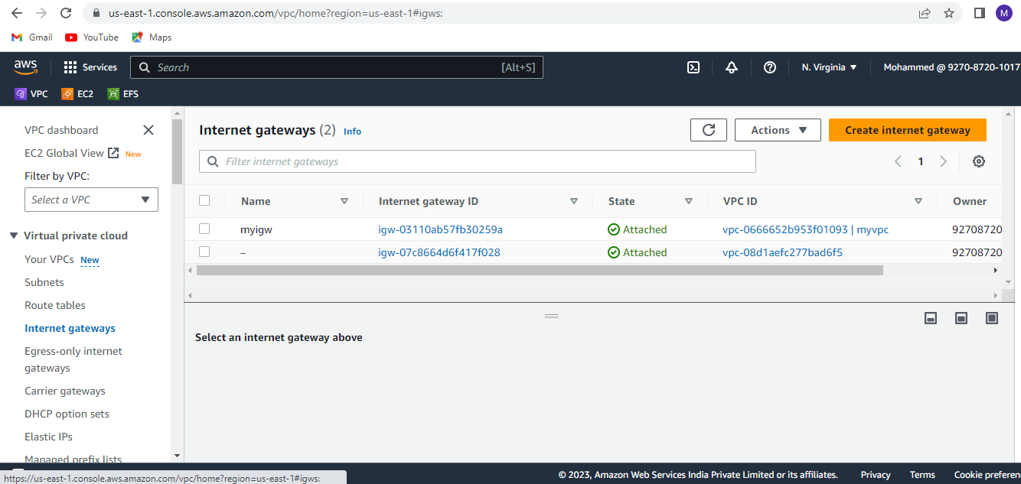
Example 2:- Create Internet Gateway by using terraform (igw.tf).
resource “aws_internet_gateway” “igw” {
vpc_id = aws_vpc.myvpc.id
tags = {
Name = “igw”
}
}
Execute terraform fmt, terraform validate, terraform plan and terraform apply command to create Internet gateway.

Slide 7
THANK YOU

